Slide 1

OPTIMISING FURNITURE SALES POTENTIAL A Business Data Management Capstone Project on Good Luck Furniture
Name: Ayan Hussain
Email: 23f1000932@ds.study.iitm.ac.in
Roll No: (23f1000932)
Date: 16.Nov.2025

Slide 2
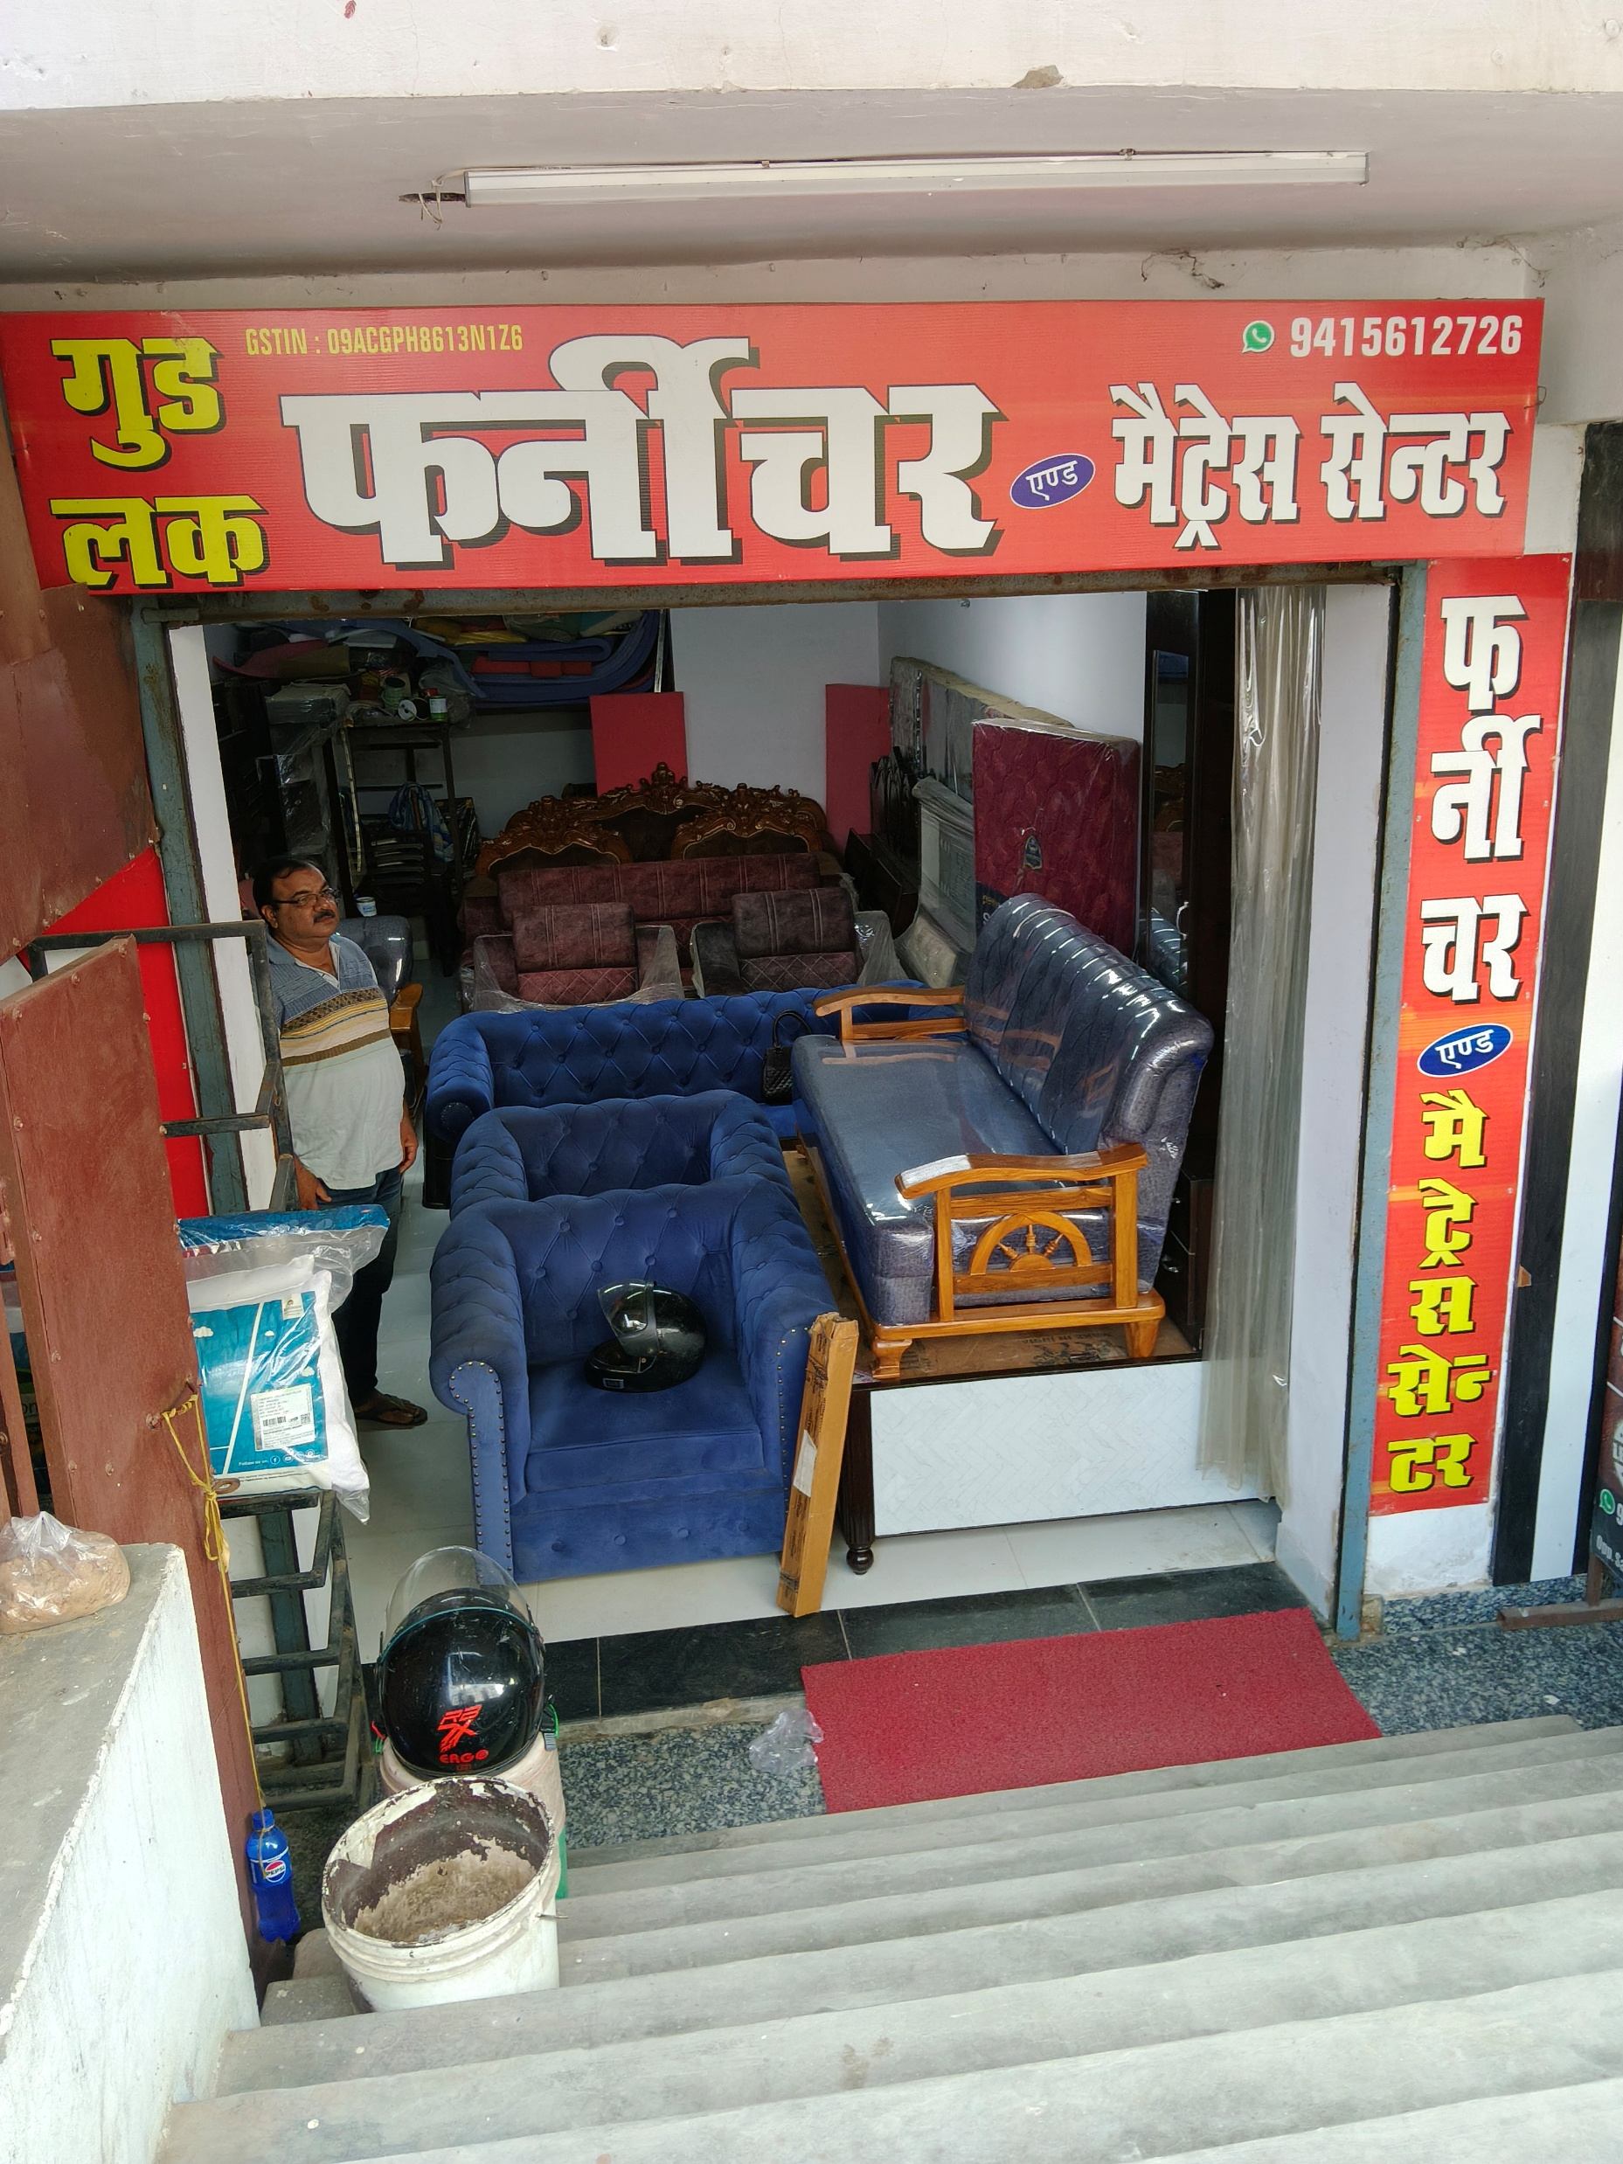
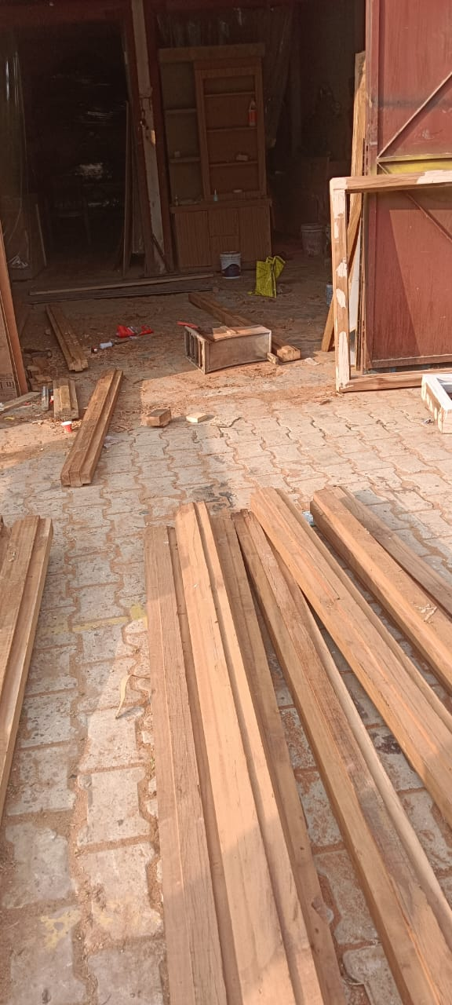
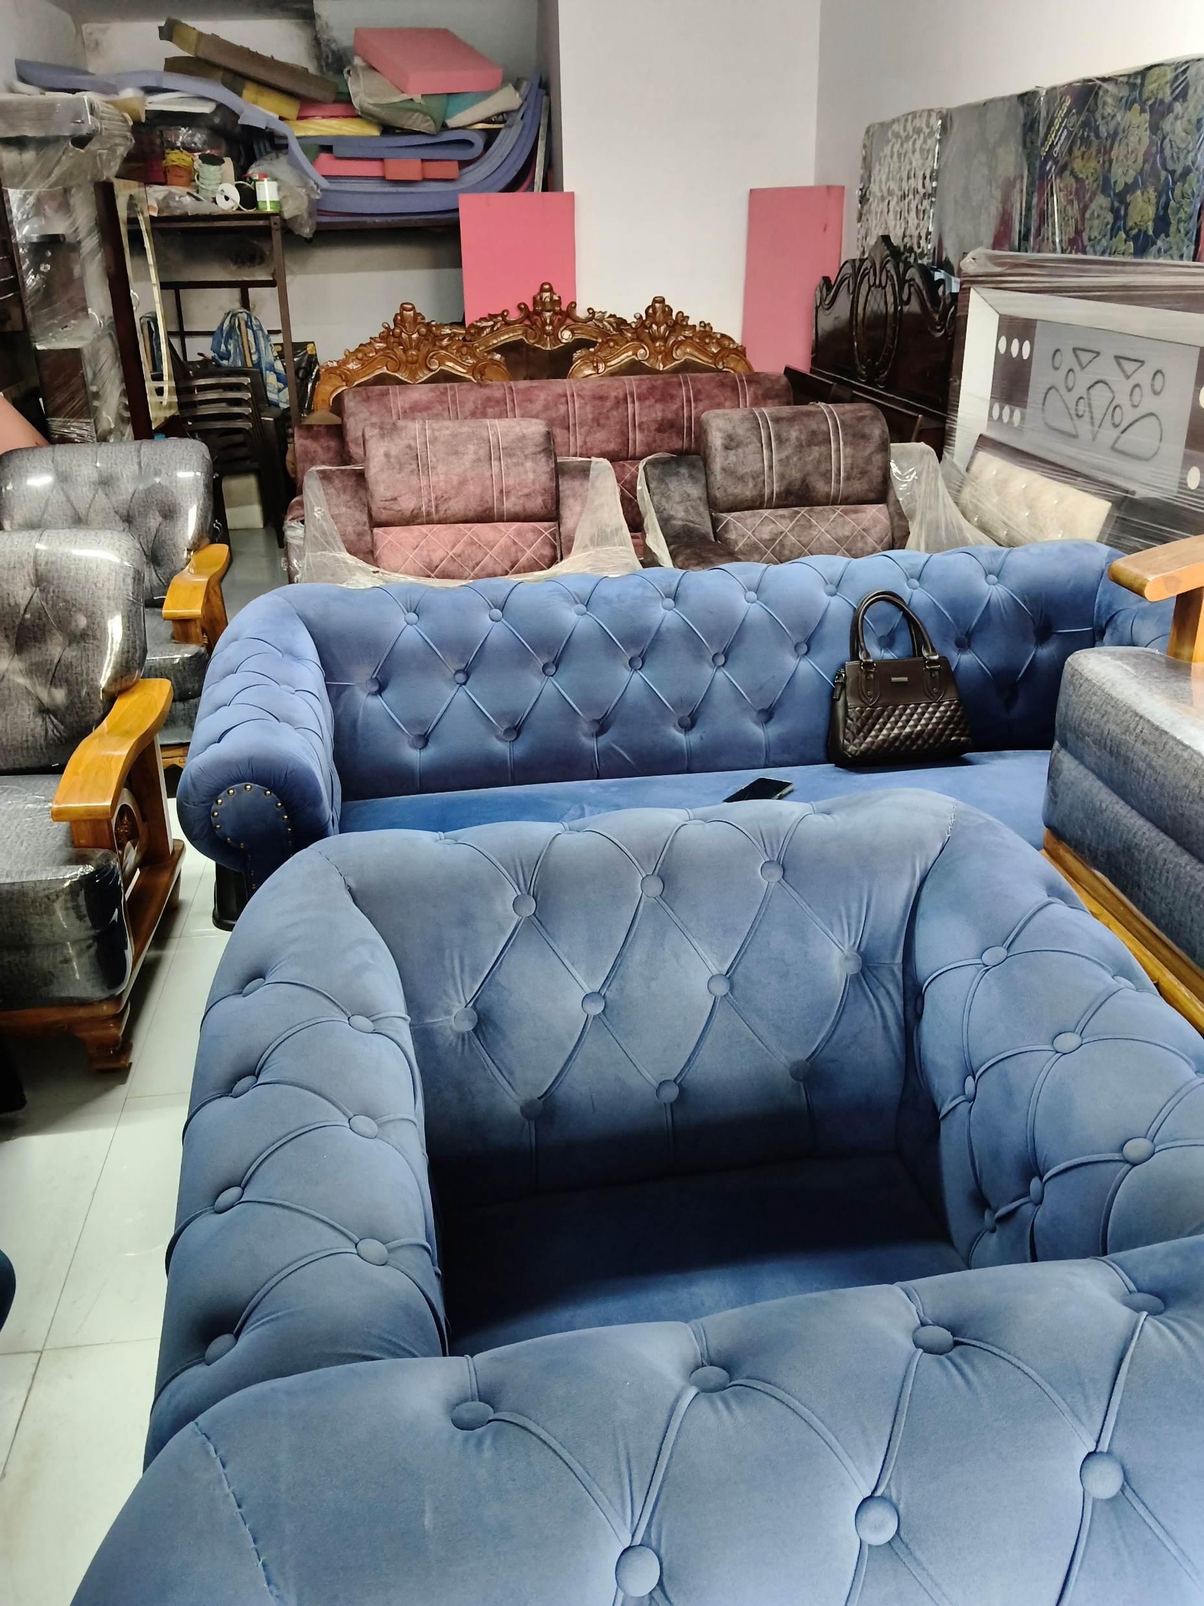
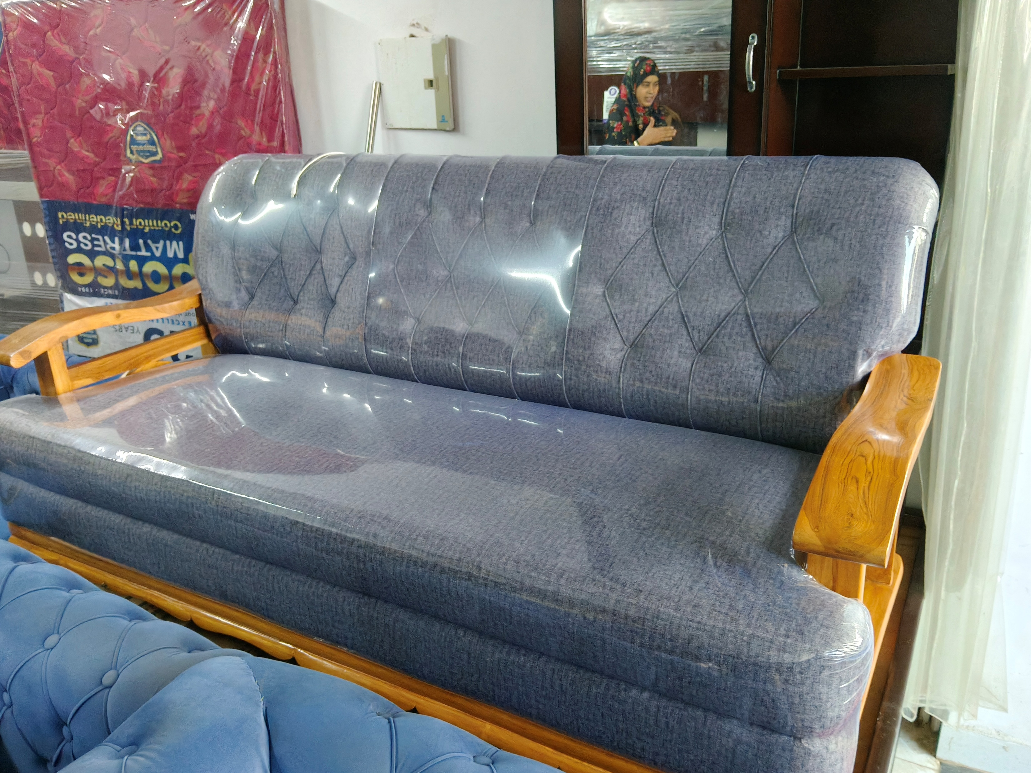
The Business & Its Challenges
The Business: Good Luck Furniture
A small-scale, family-owned business in Prayagraj, UP.
Specializes in handcrafted wooden furniture (both pre-made and
custom-designed).
Operates as a local showroom and workshop, utilizing a network
of third-party craftsmen.
Known for high-quality, durable products.

Slide 3
Problem Statements
The Core Business Challenges
Seasonal Stock Shortages: The owner identified significant lost sales due to stockouts of popular items during peak festive and wedding seasons.
Underperforming Product Portfolio: A portion of the inventory does not sell well, tying up valuable capital and showroom floor space.
Supply Chain Disruptions: Over-dependence on a few suppliers, some of whom are unreliable, causes unpredictable delays in production.

Slide 4
Metadata & Descriptive Statistics
Data Collected:
80 Sales Transactions (2023-25): Included OrderDate, ProductName, Category, UnitPrice, CostPrice, and SellingPrice.
22 Supplier Orders: Included SupplierName, PromisedDeliveryDate, and ActualDeliveryDate.
Key Descriptive Statistics:
Total Revenue (2-Yr): ₹35,24,700
Total Profit (2-Yr): ₹7,39,000
Average Profit per Sale: ₹9,853.33

Slide 5
Data Cleaning & Methodology
Data Cleaning Process:
Step 1: Converted dates → standard format (DD-MM-YYYY)
Step 2: Checked for duplicates → None found
Step 3: Calculated new key metrics: Profit (SellingPrice - CostPrice) and DeliveryDelay (Days)
Step 4: Final dataset: 80 clean records ready for analysis
Analytical Methods Used:
1. Time-Series Analysis (to find seasonal trends)
2. Profitability Analysis (to find star products)
3. Correlation Analysis (to check pricing strategy)
4. Supplier Performance Analysis (to find bottlenecks)
5. Simple Demand Forecasting (to build a solution)

Slide 6
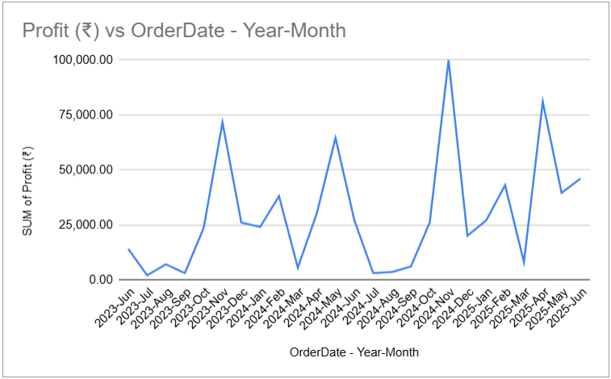
Finding 1 : The Seasonal Demand Surge
A Predictable 10x 'Boom & Bust' Cycle
Profits spike over 10x in Oct-Nov compared to monsoon lows.
This is the root cause of the "Stock Shortage" problem.

Slide 7
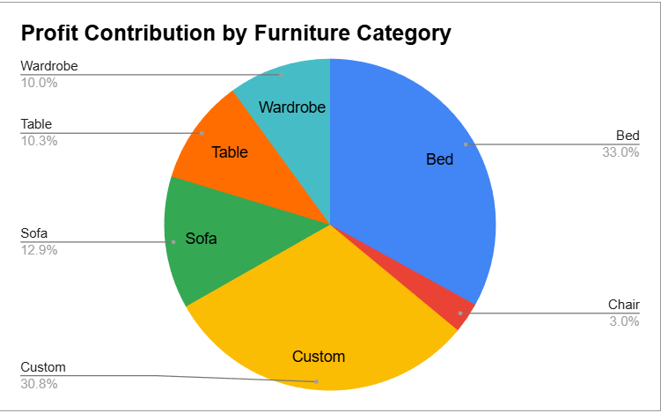
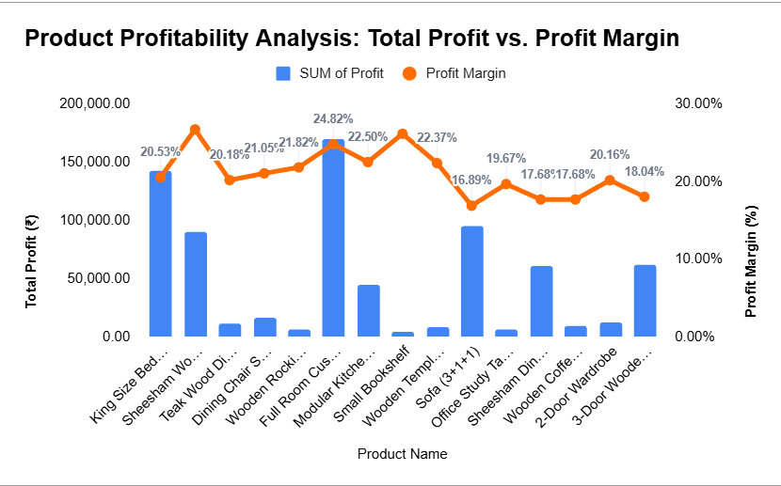
Finding 2 : The Profitability Gap
Profit is Highly Concentrated in 'Star' Products
The 'Bed' and 'Custom' categories drive 63.8% of all profit.
This identifies the “Underperforming Products”.

Slide 8
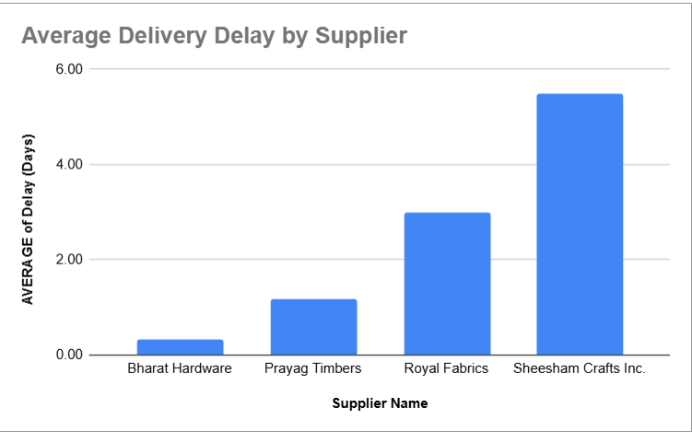
Finding 3 : The Supply Chain Bottleneck
A Single Supplier is the Key Operational Risk
Sheesham Crafts Inc.' has an average delay of 5.5 days, making it the primary bottleneck.
This identifies the source of the “Supply Chain
Disruptions”.

Slide 9
Recommendations
Solution 1: Seasonal Inventory Plan
Finding: 32.6% YoY growth in peak season.
Action: Use the ₹167,114 profit forecast to increase inventory of star products by 30% before September, not during the rush.
Solution 2: "Bundle & Clear" Strategy
Finding: Dead stock like 'Rocking Chairs' is tying up capital.
Action: Bundle these items with star products (e.g., "Buy a Sofa, get a chair 50% off") to liquidate them and reinvest the capital in popular categories like 'Beds' and 'Custom'.
Solution 3: Diversify the Supply Chain
Finding: Over-dependence on 'Sheesham Crafts Inc.'
Action: Shift 50% of orders away from this supplier. Adopt a policy of having at least two qualified suppliers for every key material.

Slide 10
Conclusion
Providing a Data-Driven Roadmap for Sustainable Growth
By implementing a seasonal inventory plan, optimizing its product mix, and diversifying suppliers, Good Luck Furniture can capture lost sales, improve cash flow, and build a resilient, profitable business.

Slide 11
Thank You
Contact: 23f100932@ds.study.iitm.ac.in Ayan Hussain

